Slide 1
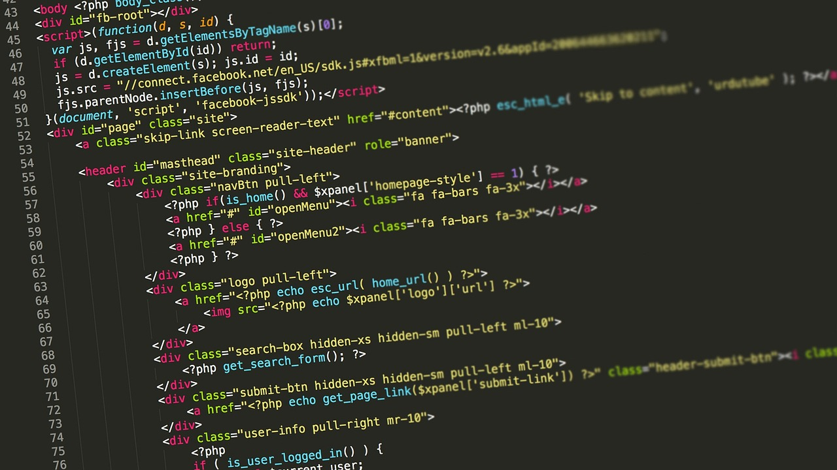
Python Programming Language
Introduction and Basic Concepts
Daniel Platero Rochart
Medical University of Graz
7.11.2023

Slide 2

Outline
wwwPthon (Why? What? Who?)
Installation and usage
Data Types and Structures
Conditionals and Loops
Code reuse

Slide 3
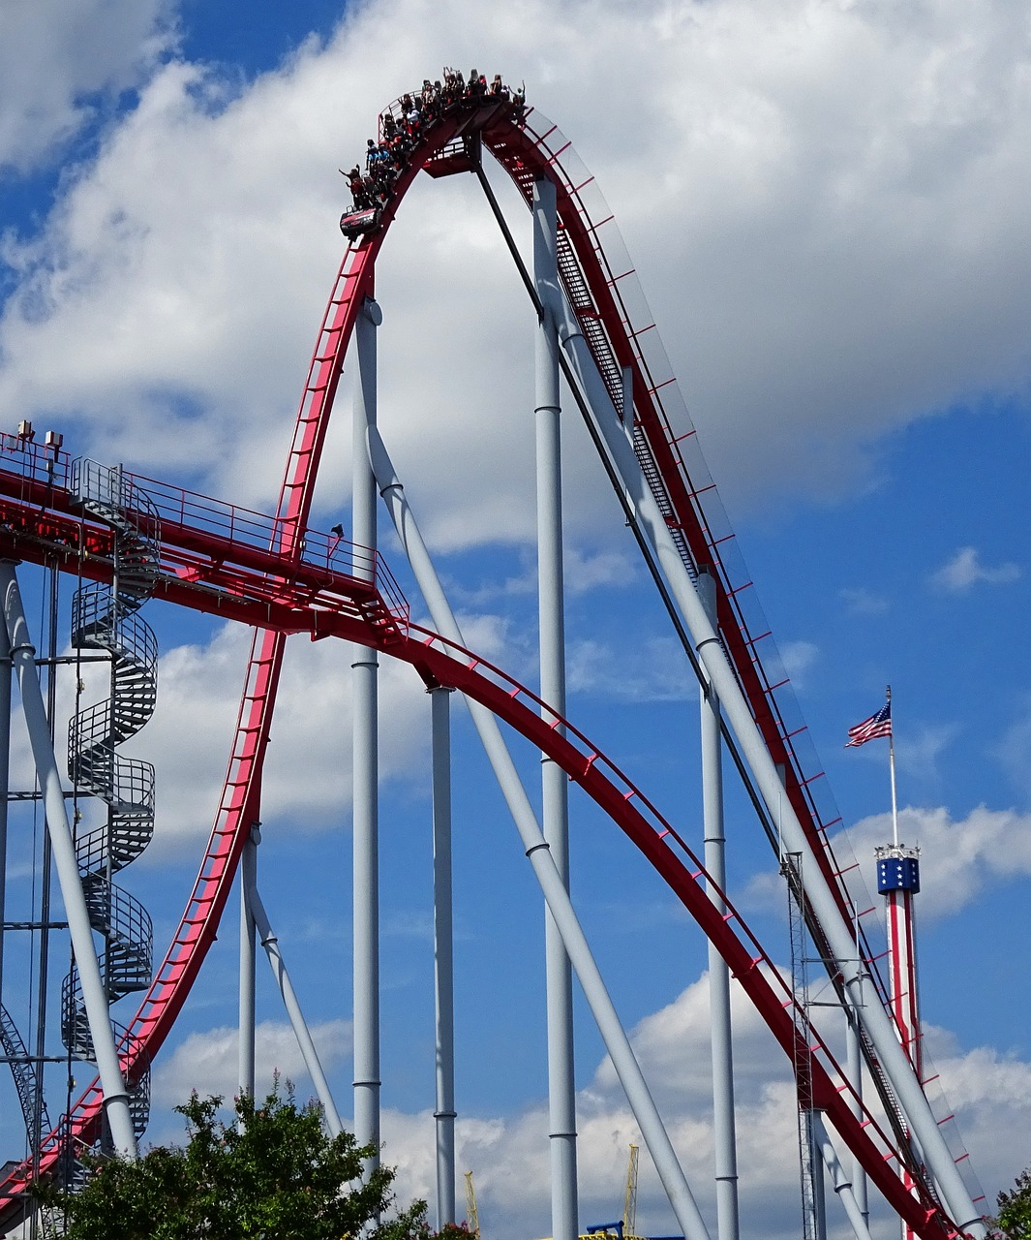
Outline
wwwPthon (Why? What? Who?)
Installation and usage
Data Types and Structures
Conditionals and Loops
Code reuse

Slide 4
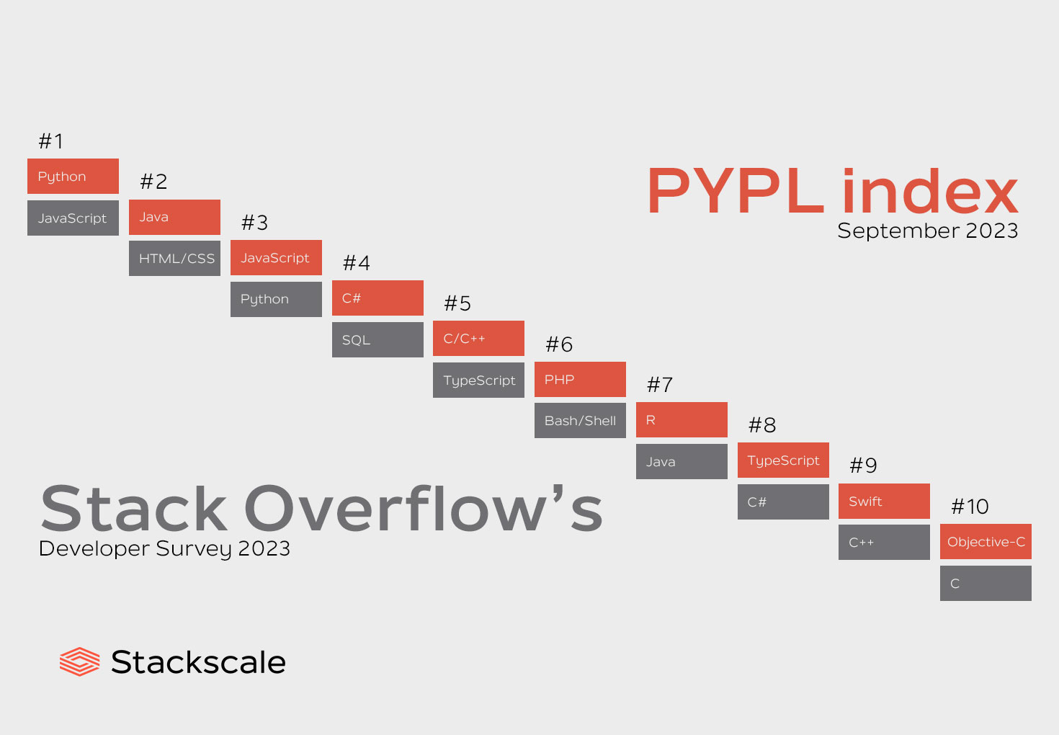
Why?
**

Slide 5
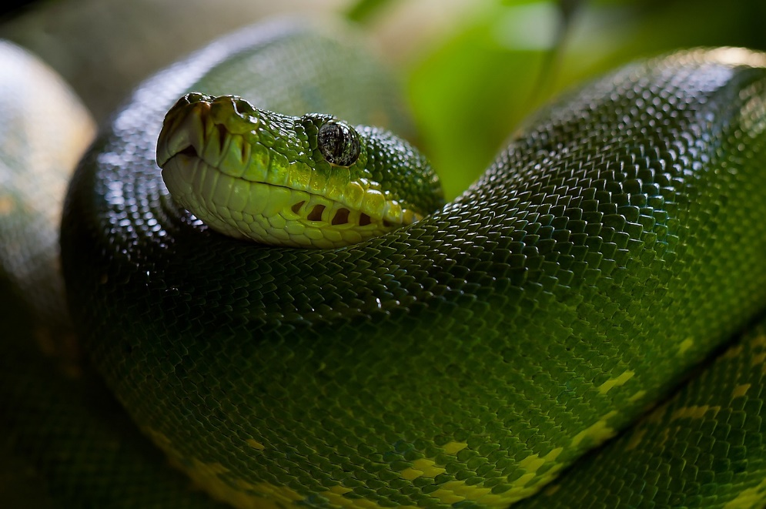
What?
Source: pixabay.com

Slide 6
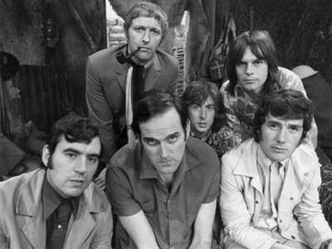
What?
Source: pixabay.com
Source: wikipedia.org

Slide 7
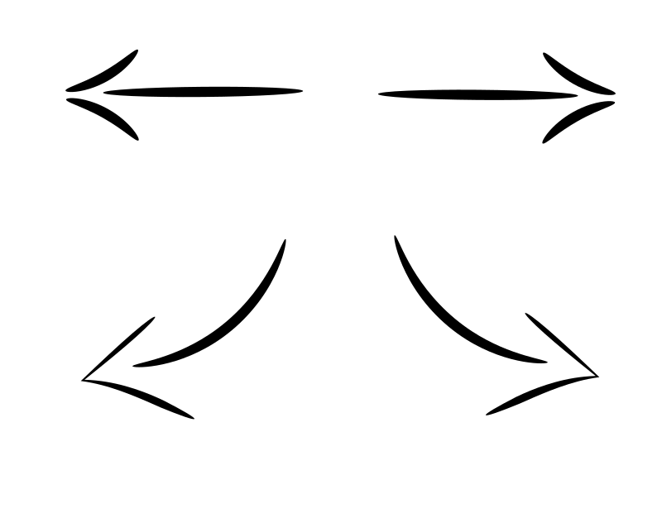
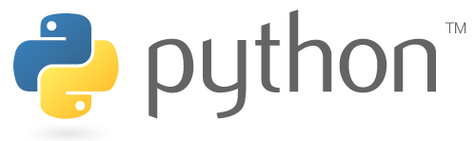
What?
Source: pixabay.com
Source: wikipedia.org
Source: python.org

Slide 8
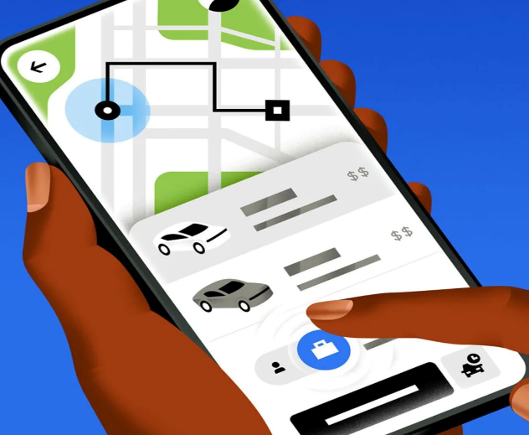
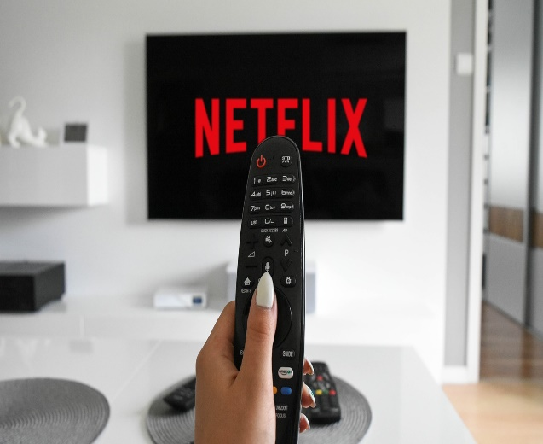



Who?

Slide 9
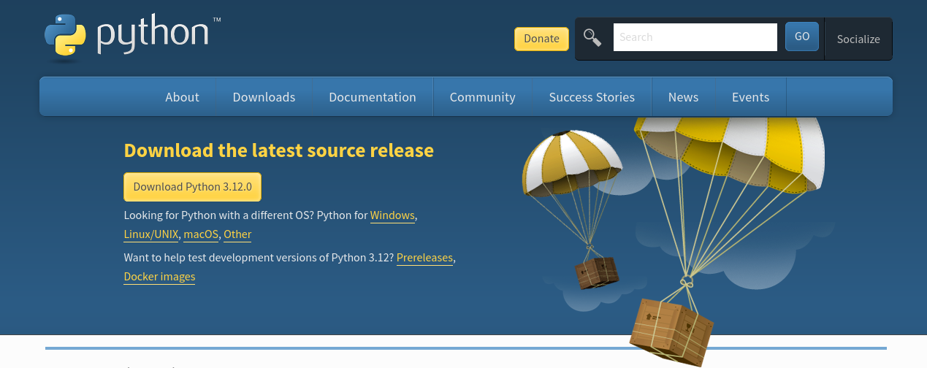
Why?
Portability

Slide 10
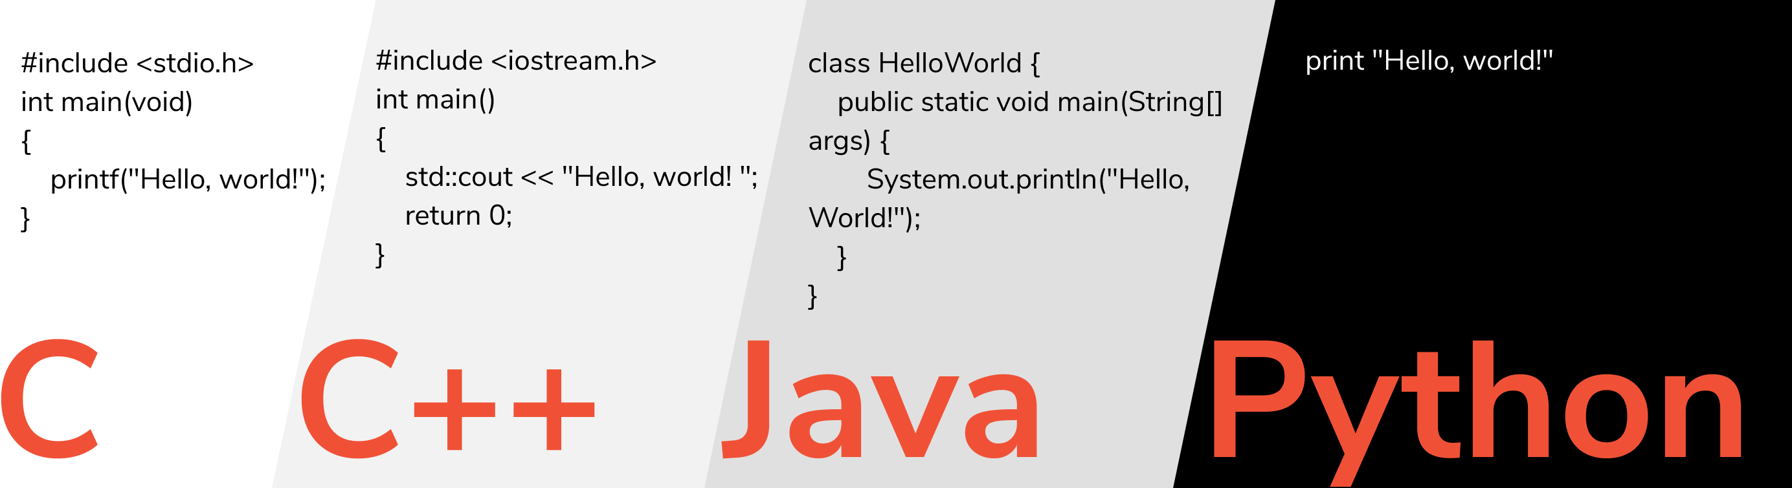
Why?
Portability
Productivity

Slide 11
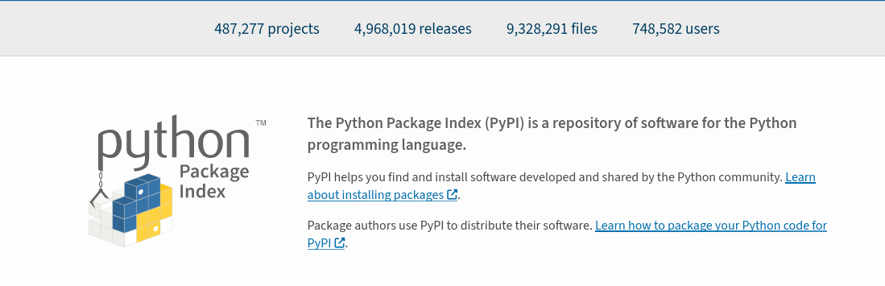
Why?
Portability
Productivity
Extensive library

Slide 12
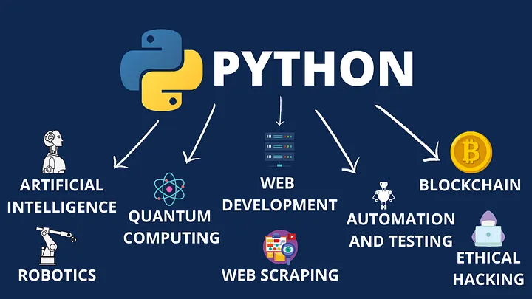
Why?
Portability
Productivity
Extensive library
Versatility

Slide 13
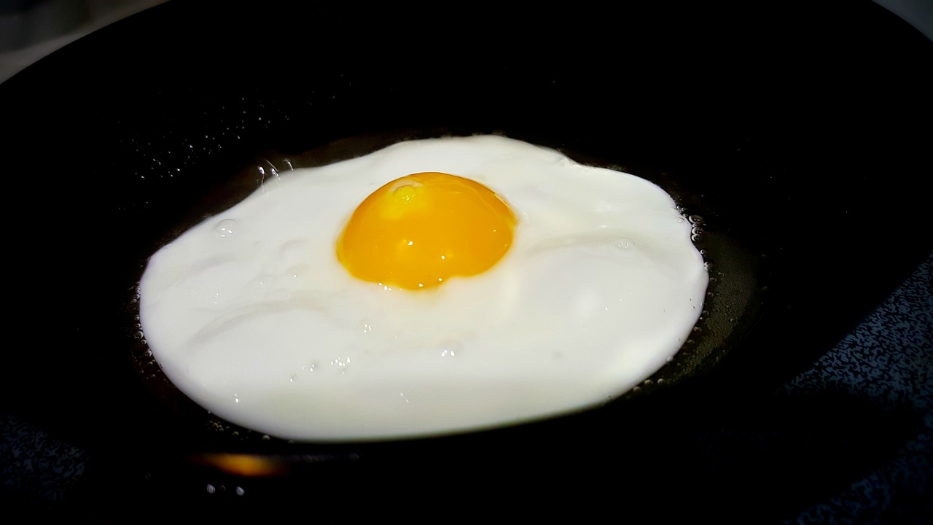

Slide 14
What?
Python is an interpreted, object-oriented, high-level programming language with dynamic semantics. Its high-level built in data structures, combined with dynamic typing and dynamic binding, make it very attractive for Rapid Application Development, as well as for use as a scripting or glue language to connect existing components together. Python's simple, easy to learn syntax emphasizes readability and therefore reduces the cost of program maintenance. Python supports modules and packages, which encourages program modularity and code reuse. The Python interpreter and the extensive standard library are available in source or binary form without charge for all major platforms, and can be freely distributed.

Slide 15
What?
Python is an interpreted, object-oriented, high-level programming language with dynamic semantics. Its high-level built in data structures, combined with dynamic typing and dynamic binding, make it very attractive for Rapid Application Development, as well as for use as a scripting or glue language to connect existing components together. Python's simple, easy to learn syntax emphasizes readability and therefore reduces the cost of program maintenance. Python supports modules and packages, which encourages program modularity and code reuse. The Python interpreter and the extensive standard library are available in source or binary form without charge for all major platforms, and can be freely distributed.
https://python.org/doc/essays/blurb/

Slide 16
Compiled vs Interpreted

Slide 17
Compiled vs Interpreted
Compiled
Converts the user’s code (high-level) in commands that a machine can understand and it can be directly executed by the CPU (low-level)

Slide 18
Compiled vs Interpreted
Compiled
Converts the user’s code (high-level) in commands that a machine can understand and it can be directly executed by the CPU (low-level)
C++, Java, Fortran

Slide 19
Compiled vs Interpreted
Compiled
Converts the user’s code (high-level) in commands that a machine can understand and it can be directly executed by the CPU (low-level)
C++, Java, Fortran
Interpreted
The interpreter reads the code line by line and converts each executed line into machine code.

Slide 20
Compiled vs Interpreted
Compiled
Converts the user’s code (high-level) in commands that a machine can understand and it can be directly executed by the CPU (low-level)
C++, Java, Fortran
Interpreted
The interpreter reads the code line by line and converts each executed line into machine code.
Python, Ruby, JavaScript

Slide 21
OOP
Object Oriented Programming
Based on the notion of “object”, is a programming paradigm (classification) that binds properties and behaviors to certain objects.

Slide 22
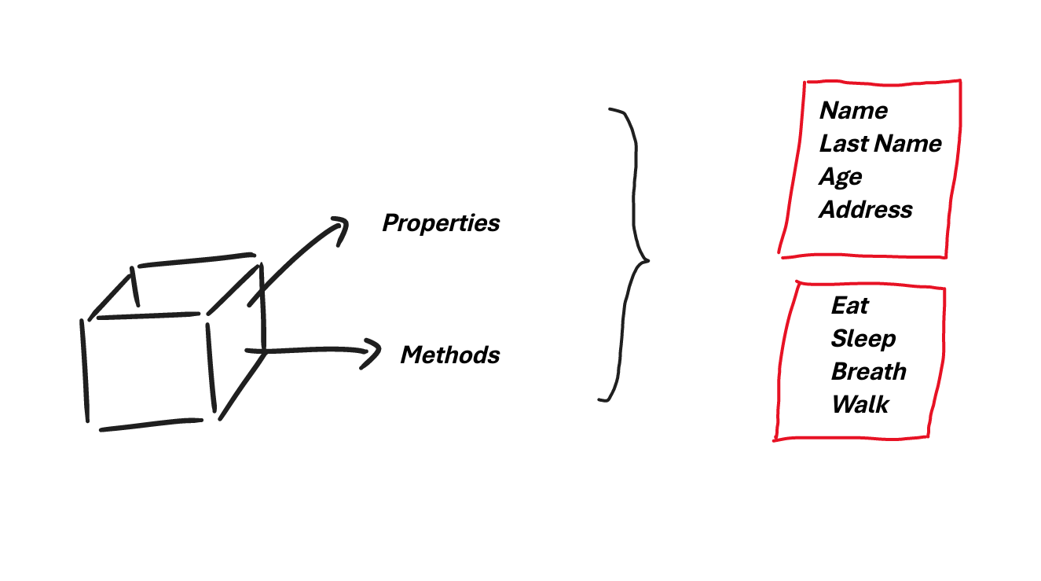
OOP
Object Oriented Programming
Based on the notion of “object”, is a programming paradigm (classification) that binds properties and behaviors to certain objects.
https://en.wikipedia.org/wiki/Programming_paradigm
https://realpython.com/python3-object-oriented-programming/

Slide 23
OOP
Object Oriented Programming
Based on the notion of “object”, is a programming paradigm (classification) that binds properties and behaviors to certain objects.
https://en.wikipedia.org/wiki/Programming_paradigm
https://realpython.com/python3-object-oriented-programming/

Slide 24
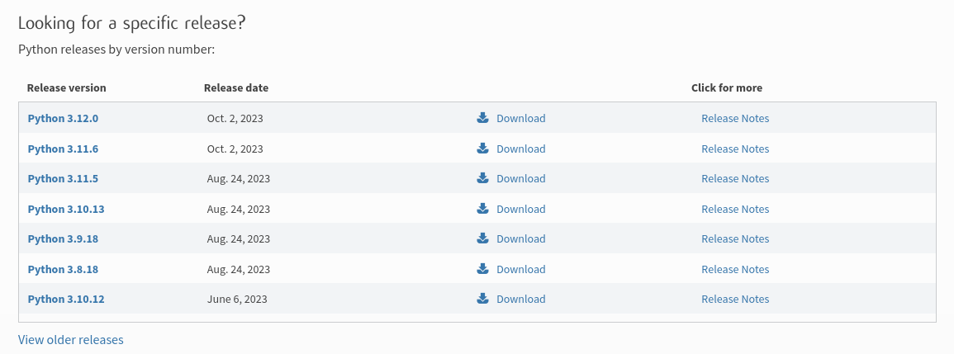
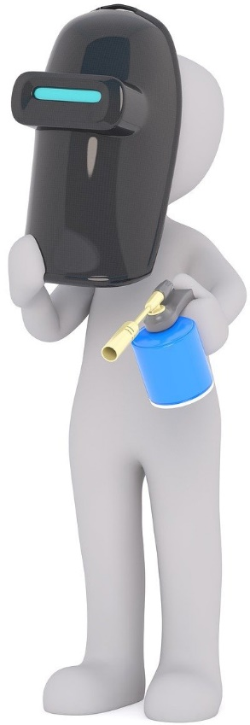
Install Python

Slide 25
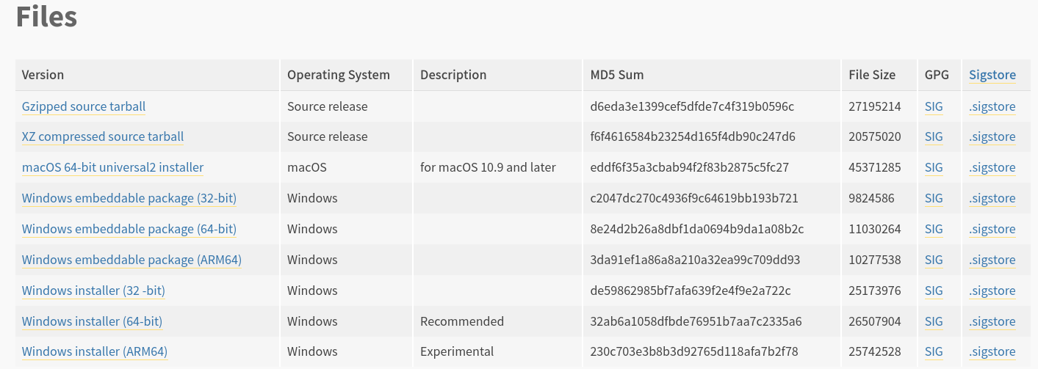
Install Python

Slide 26
Install Python

Slide 27
Install Python

Slide 28
Install Python

Slide 29
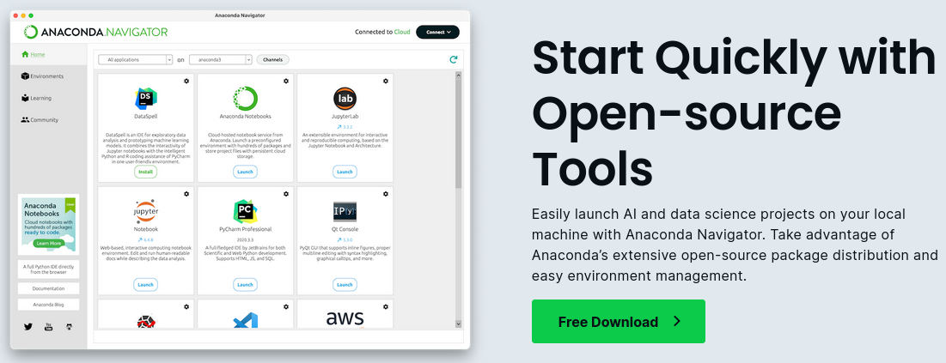
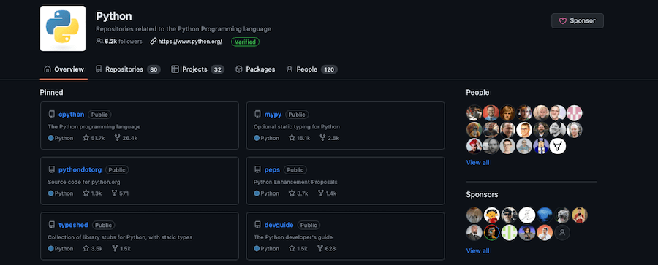
Install Python
$ sudo apt-get install python3
$ sudo yum install python3

Slide 30
Install Python
$ sudo apt-get install python3
$ sudo yum install python3

Slide 31
Write and Execute
From the terminal (console): $ python3 file.py

Slide 32
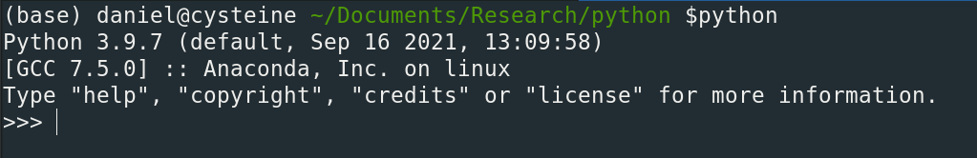
Write and Execute
From the terminal (console): $ python3 file.py
From the Python interactive shell: $python3

Slide 33
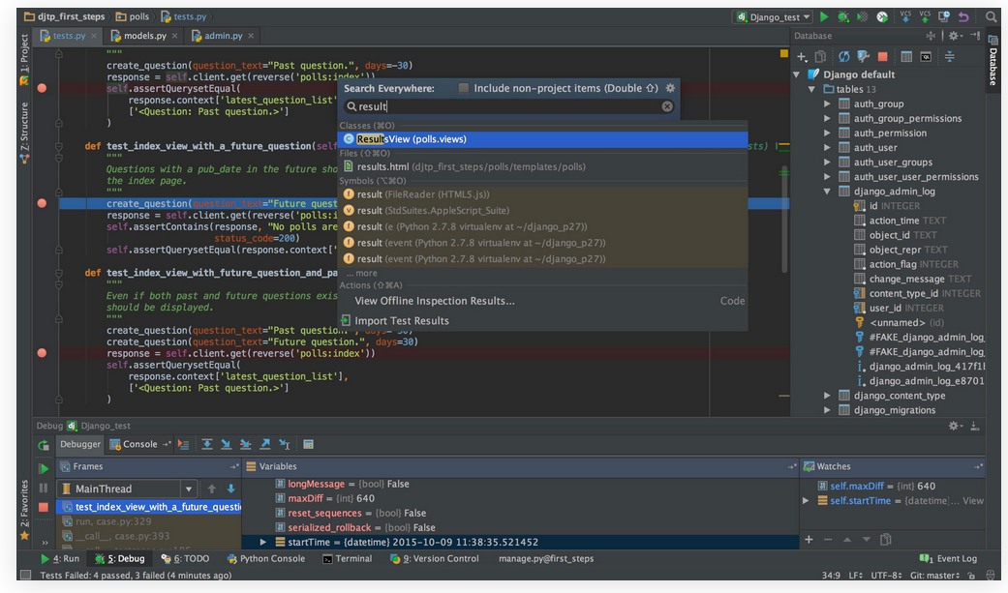
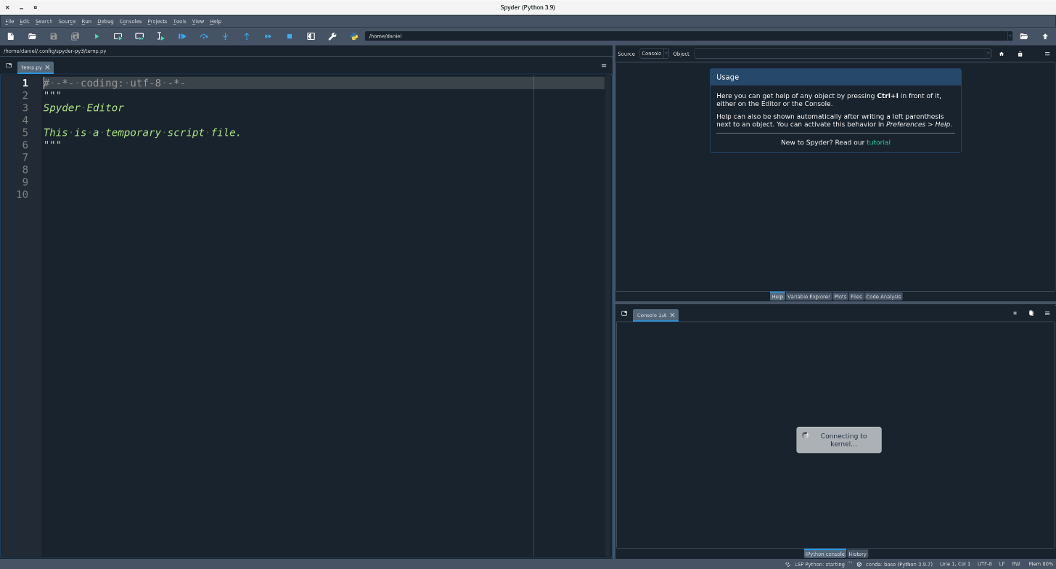
Write and Execute
From the terminal (console): $ python3 file.py
From the Python interactive shell: $python3
Using an IDLE (Integrated DeveLopment Environment): PyCharm, Spyder

Slide 34
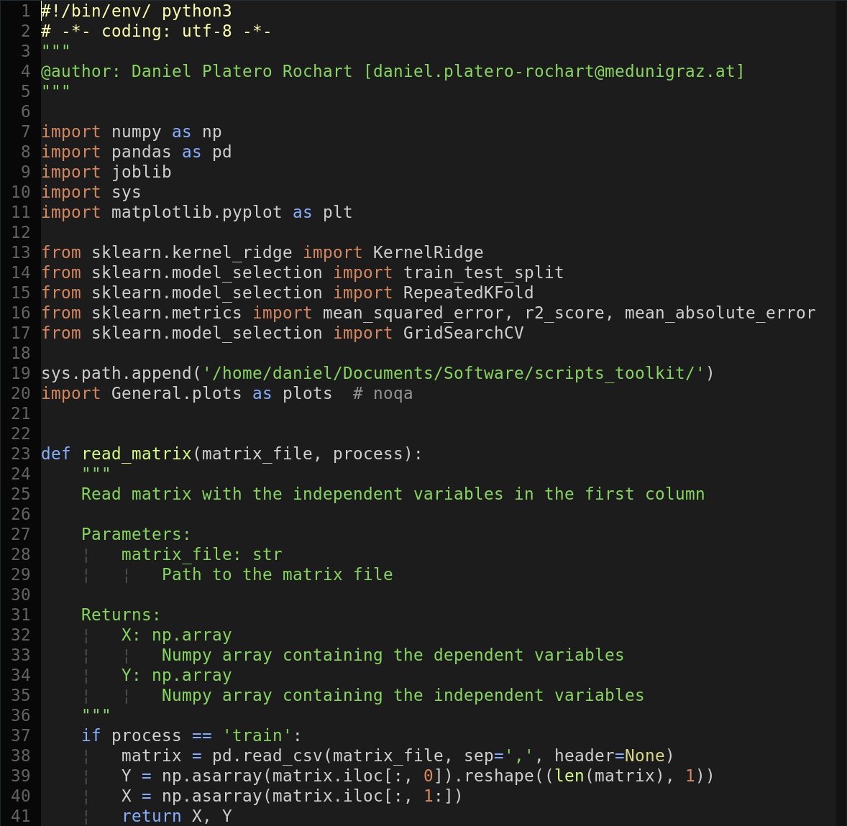
Write and Execute
From the terminal (console): $ python3 file.py
From the Python interactive shell: $python3
Using an IDLE (Integrated DeveLopment Environment): PyCharm, Spyder
Using a text editor (Vim, Neovim, Sublime Text, etc…)

Slide 35
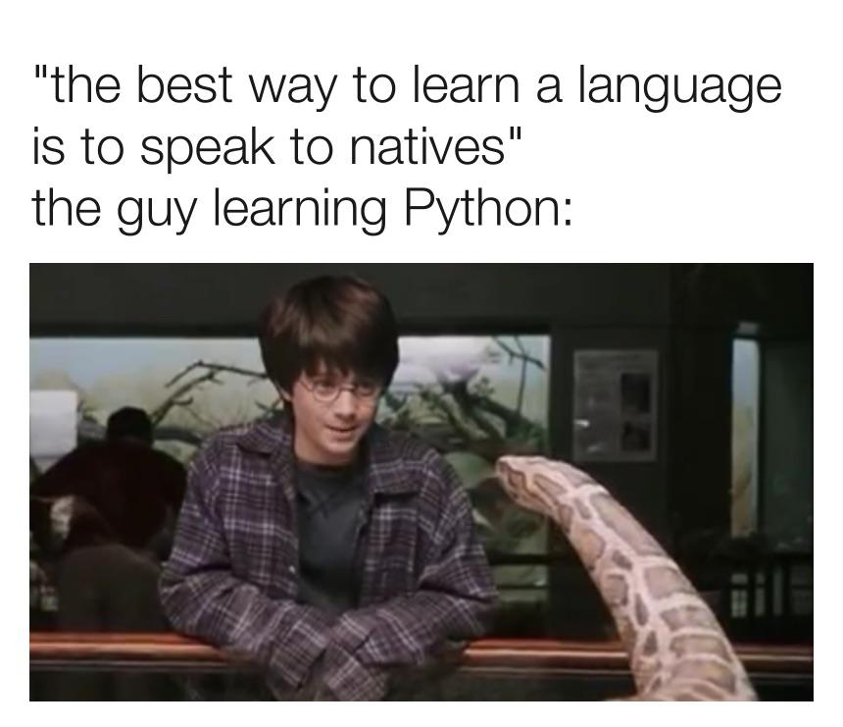
Exercise 1: Example
Use the python console to print the message “Hello World!”

Slide 36
Data Types
Strings
It is handled using the str object and are immutable sequences of Unicode code points (UTF-8).

Slide 37
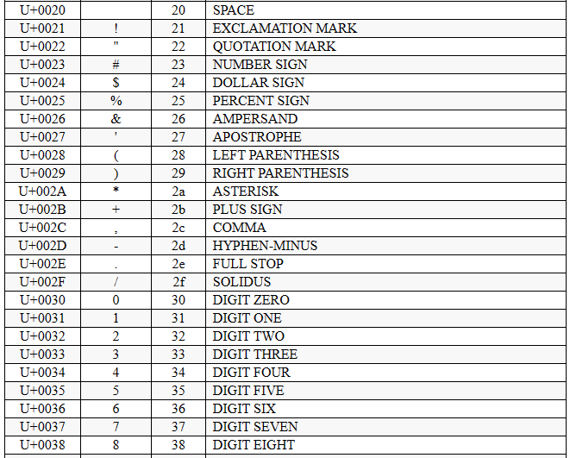
Data Types
Strings
It is handled using the str object and are immutable sequences of Unicode code points (UTF-8).

Slide 38
Data Types
Strings
It is handled using the str object and are immutable sequences of Unicode code points (UTF-8).
text1 = ‘This is a string’
text2 = “This is also a string”

Slide 39
Data Types
Strings
It is handled using the str object and are immutable sequences of Unicode code points (UTF-8).
text1 = ‘This is a string’
text2 = “This is also a string”
text3 = ‘‘‘This is a
multiline string’’’
text4 = “““This is too a
multiline string”””

Slide 40
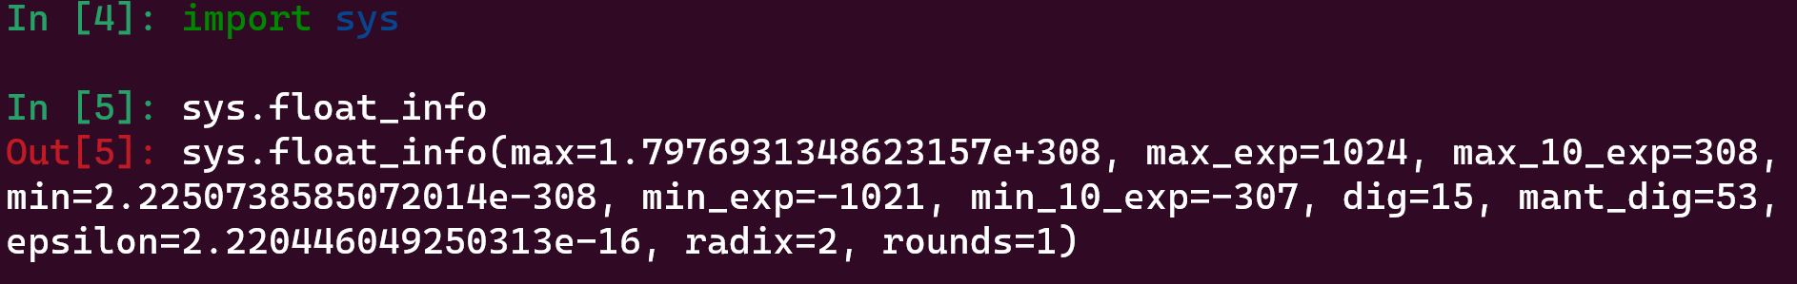
Data Types
Numeric values
Python has three different numeric values: integers, floating point, and complex numbers. In addition, Booleans can be used as integers (subtype).
a = int(42) # unlimited precision (limited only by memory)
a = float(42.5) # implemented using double in C (sys.float_info)

Slide 41
Data Types
Numeric values
Python has three different numeric values: integers, floating point, and complex numbers. In addition, Booleans can be used as integers (subtype).
a = complex(1, -3) # contain a real (re) and imaginary part (im), both of them can be float values
print(a)
(1-3j)
a.real
>>> 1
a.imag
>>> -3

Slide 42
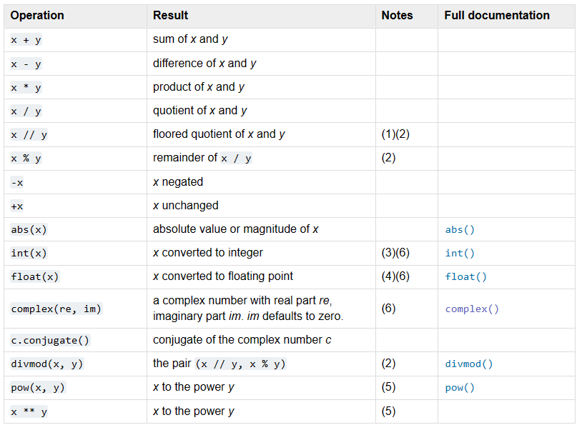
Data Types

Slide 43
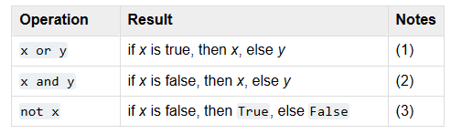
Data Types
Booleans
True (1) or False (0).

Slide 44
Data Structures
Lists
Use to store collections of homogeneous or heterogeneous items.
a = []
a = list()
a.append() # append 4 to the list
a.extend(iterable) # extend the list using an iterable
a.remove() # remove ‘2’ from the list
a.reverse() # reverse the order of the list
a.sort() # sort the list

Slide 45
Data Structures
Lists
Use to store collections of homogeneous or heterogeneous items.
min() # find the minimum value
max() # find the maximum value
len() # number of elements in the list
sum() # sum the values in the list

Slide 46
Data Structures
Sets
Unordered collection of data. Do not support indexing or slicing. Commonly used to test membership, remove duplicates, and mathematical operations like union, intersection etc.
a = set()
a = {}
a.add()
a.remove()
min(a)
max(a)

Slide 47
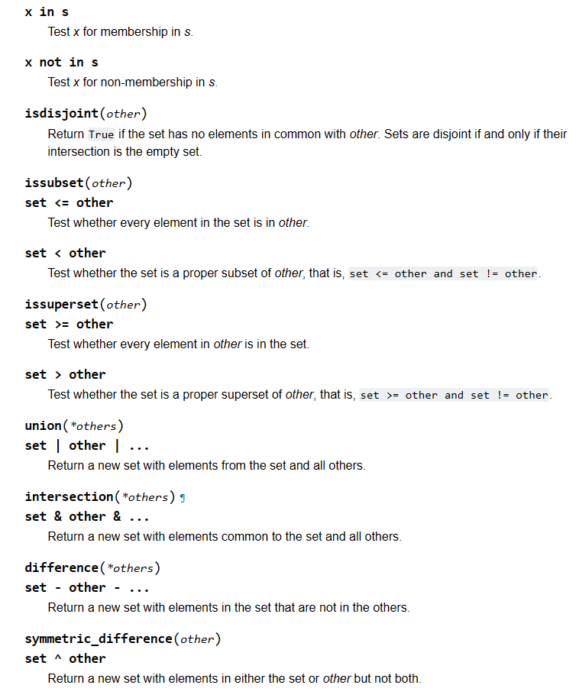
Data Structures

Slide 48
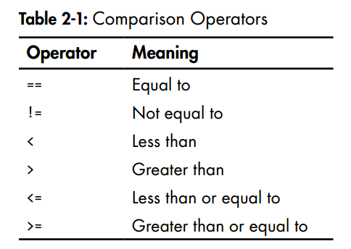
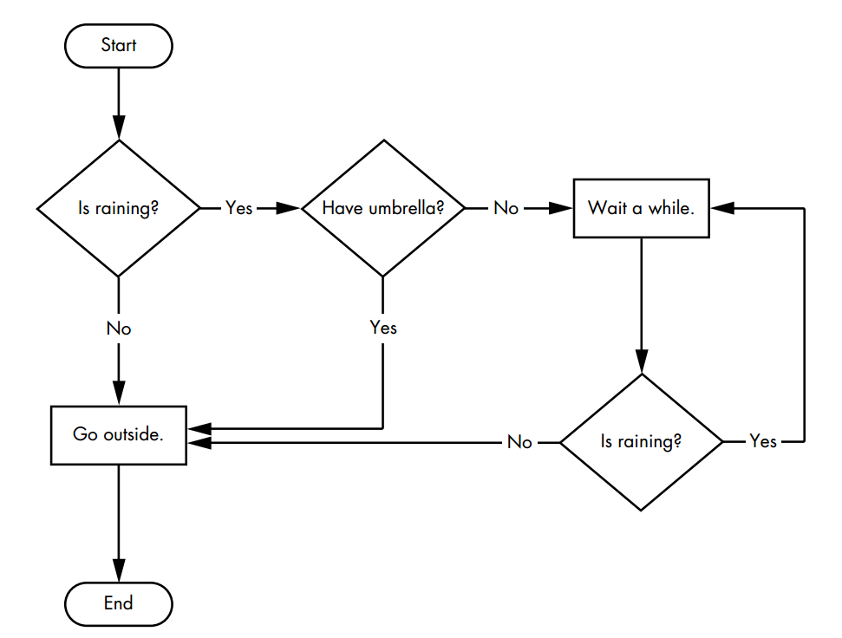
Conditions

Slide 49
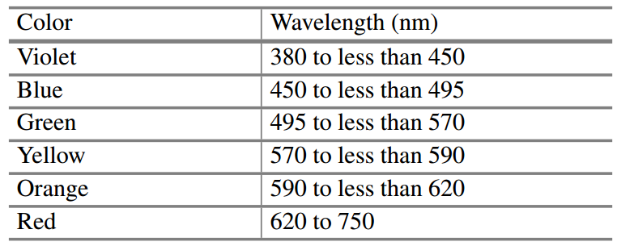
Conditions
Exercise 2:
Create a program that returns the roots of a Quadratic function.
Exercise 3:
Create a program that returns the color of a given wavelength in the visible light range.

Slide 50
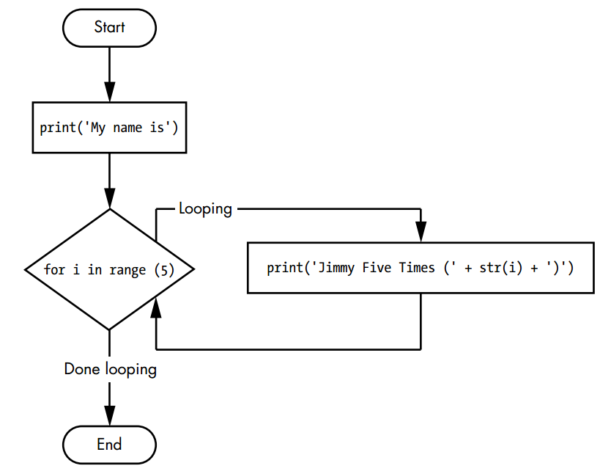
Looping

Slide 51
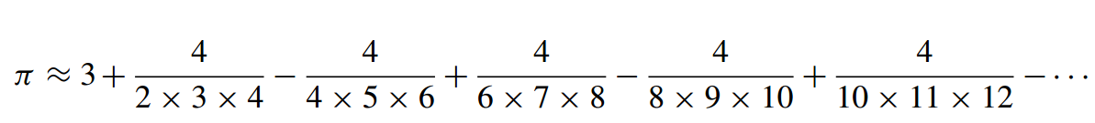
Looping
Exercise 4:
Create a program that returns pi approximations
Exercise 5:
Create a program that returns prime numbers up to a certain value.

Slide 52
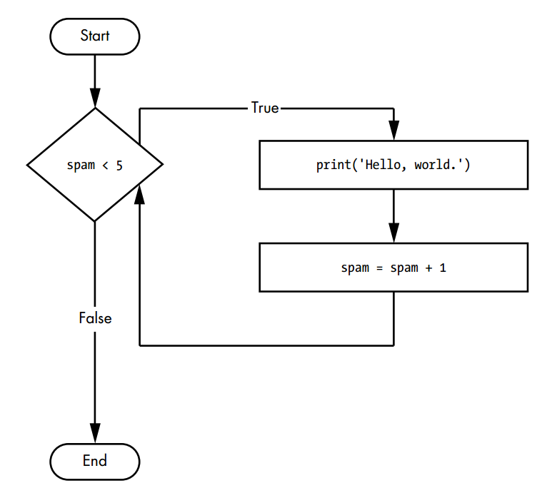
Looping

Slide 53
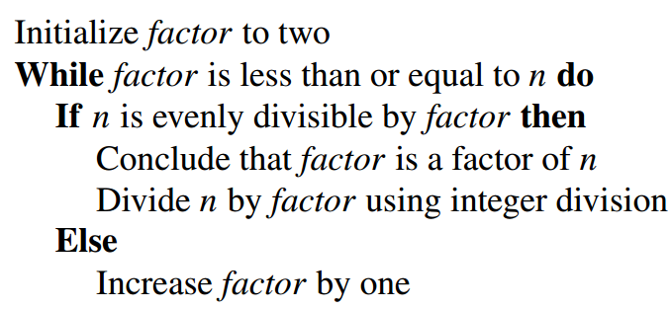
Looping
Exercise 6:
Create a program that returns the square root using the newton’s method
Exercise 7:
Create a program that returns the prime factorization of any number.

Slide 54
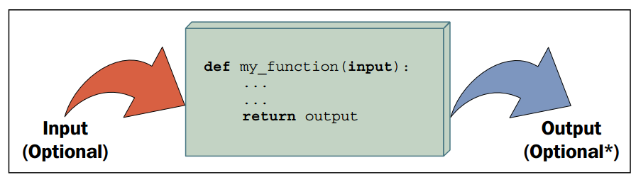
Functions

Slide 55
Automate the boring stuff with Python. Practical Programming for total beginners. Al Sweigart.
Learning Python. Fabrizio Romano.
The Python Workbook. A brief introduction with exercises and solutions. Ben Stephenson.

Slide 56
Automate the boring stuff with Python. Practical Programming for total beginners. Al Sweigart.
Learning Python. Fabrizio Romano.
The Python Workbook. A brief introduction with exercises and solutions. Ben Stephenson.
https://wiki.python.org/moin/BeginnersGuide/NonProgrammers

Slide 57
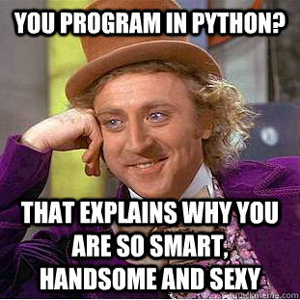
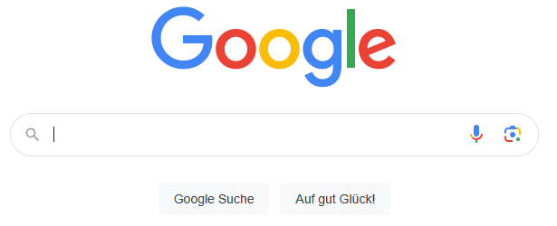
Automate the boring stuff with Python. Practical Programming for total beginners. Al Sweigart.
Learning Python. Fabrizio Romano.
The Python Workbook. A brief introduction with exercises and solutions. Ben Stephenson.
https://wiki.python.org/moin/BeginnersGuide/NonProgrammers

